Slide 1
Fundamentals of Data Engineering

Slide 2
Role of Data Engineering in Modern Data Platforms
What Data Engineering Actually Does
Data Engineering is responsible for:
Collecting data
Processing it
Storing it
Making it usable for analytics, ML, and business
Think of it as building highways for data.
In a Modern Data Platform:
Data Sources → Data Engineering → Storage → Analytics / ML / BI

Slide 3
Key Responsibilities:
Build data pipelines (ETL/ELT)
Ensure data reliability & quality
Optimize performance & cost
Enable data accessibility
Real-world Example:
At Netflix:
Engineers build pipelines that process billions of events/day
This feeds:
Recommendation systems
User analytics
Monitoring systems

Slide 4
Data Sources and Data Collection Methods
Types of Data Sources
Structured Data
Databases (MySQL, PostgreSQL)
Example: user table
Semi-Structured
JSON, XML
Example: API responses
Unstructured
Logs, images, videos
Example: application logs

Slide 5
Data Collection Methods
1. Batch Ingestion
Data collected periodically (hourly/daily)
Tools:
Airflow
Cron jobs
Example:
Daily sales data → Load into warehouse at midnight
2. Real-Time Ingestion (Streaming)
Data collected instantly
Tools:
Kafka
Kinesis
Example:
User clicks → sent instantly to pipeline → dashboard updates

Slide 6
Data Collection Methods
3. API-Based Collection
Pull data from external services
import requests
data = requests.get("https://api.example.com/users").json()
4. Log-Based Collection
Applications generate logs → collected
Example tools:
Fluentd
Logstash

Slide 7
Data Quality Challenges & Data Cleaning Techniques
Common Data Quality Issues
Issue | Example
Missing Data | age = NULL
Duplicate Data | Same user twice
Inconsistent Format | "USA" vs "United States"
Invalid Data | age = -5
Outliers | salary = 1,000,000 (error)

Slide 8
Data Cleaning Techniques
1. Handling Missing Values
df.fillna(0)
2. Removing Duplicates
df.drop_duplicates()
3. Standardization
df['country'] = df['country'].str.upper()
4. Validation Rules
Age must be > 0
Email must match regex
5. Advanced (Production Level)
Schema validation (Pydantic, Great Expectations)
Data contracts
Automated anomaly detection

Slide 9
Data Lakes vs Data Warehouses
Data Lake
Definition:
Stores raw data in any format
Tools:
AWS S3
Azure Data Lake
Characteristics:
Schema-on-read
Cheap storage
Flexible
Example:
Store logs, JSON, images directly

Slide 10
Data Lakes vs Data Warehouses
Data Warehouse
Definition:
Stores structured, cleaned data
Tools:
Snowflake
BigQuery
Redshift
Characteristics:
Schema-on-write
Optimized for analytics
Fast queries

Slide 11
Key Differences
Feature | Data Lake | Data Warehouse
Data Type | Raw | Processed
Schema | Flexible | Fixed
Cost | Low | Higher
Use Case | ML, exploration | BI, dashboards

Slide 12
Lakehouse
Modern Architecture (Lakehouse)
Combination of both:
Delta Lake
Apache Iceberg

Slide 13
Concept of Data Pipelines
Definition:
A data pipeline is a system that: Moves data from source → destination and transforms it
Pipeline Stages
[Ingestion] → [Processing] → [Storage] → [Serving]
Components
1. Source
DB, API, logs
2. Ingestion Layer
Kafka, Airbyte
3. Processing Layer
Spark, Flink
4. Storage
Data Lake / Warehouse
5. Orchestration
Airflow
6. Serving Layer
BI tools, APIs
Example Pipeline: MySQL → Kafka → Spark → S3 → Snowflake → Tableau

Slide 14
Real-Time vs Batch Processing
Batch Processing
Definition:
Process data in chunks
Tools:
Apache Spark
Hadoop
Pros:
Cost efficient
Easy to manage
Cons:
Not real-time
Example:
Daily sales report

Slide 15
Real-Time vs Batch Processing
Real-Time Processing
Definition:
Process data instantly
Tools:
Kafka
Apache Flink
Pros:
Immediate insights
Better user experience
Cons:
Complex
Expensive
Example:
Fraud detection in banking

Slide 16
Real-Time vs Batch Processing
Feature | Batch | Real-Time
Speed | Slow | Instant
Cost | Low | High
Complexity | Low | High

Slide 17
DEMO

Slide 18
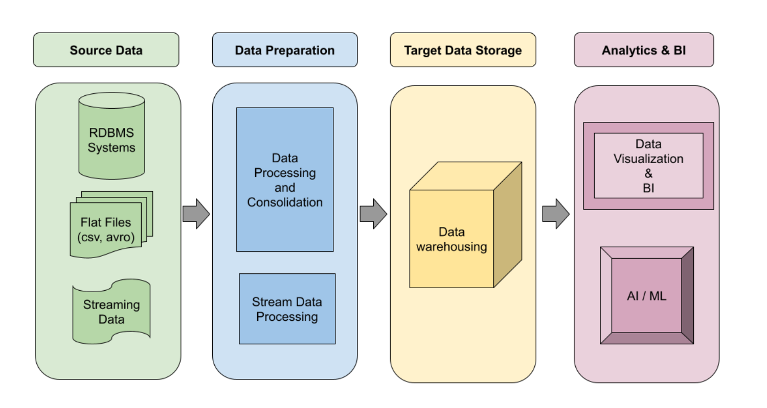
What is Data Pipeline Architecture?
Notes:
High-Level Architecture
[Data Sources] → [Ingestion Layer] → [Processing/Transformation] → [Storage] → [Consumption]

Slide 19
What is Data Pipeline Architecture?
A data pipeline is a system that moves data from source → processing → storage → consumption.
Core Goal:
Move data reliably
Transform it into usable format
Deliver it on time

Slide 20
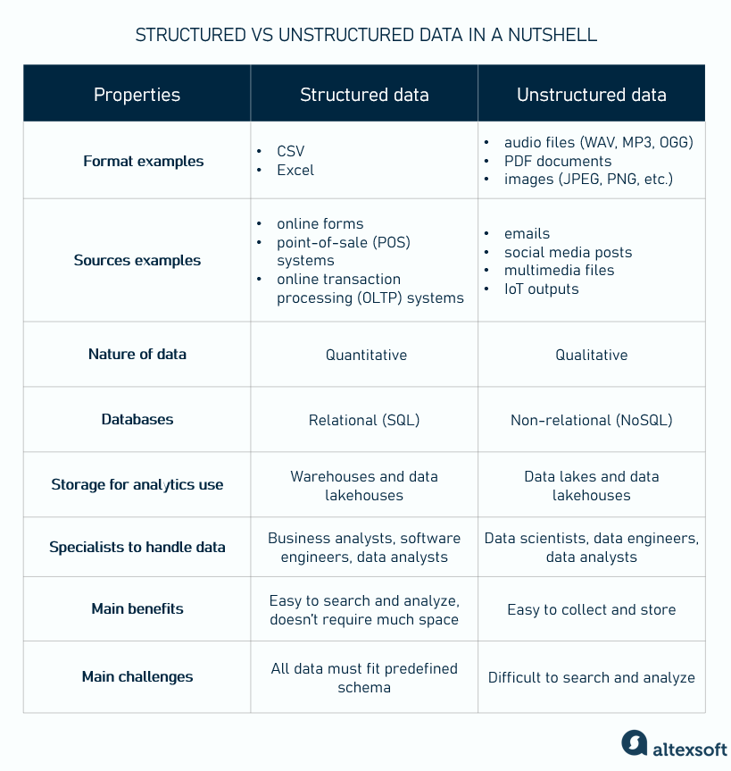
Data Pipeline Layers
Data Sources
Types:
Structured → Databases (MySQL, PostgreSQL)
Semi-structured → JSON, XML, logs
Unstructured → Images, videos, text
Streaming → IoT sensors, clickstreams
Real Example:
E-commerce app:
Orders DB
User activity logs
Payment API
Recommendation events

Slide 21
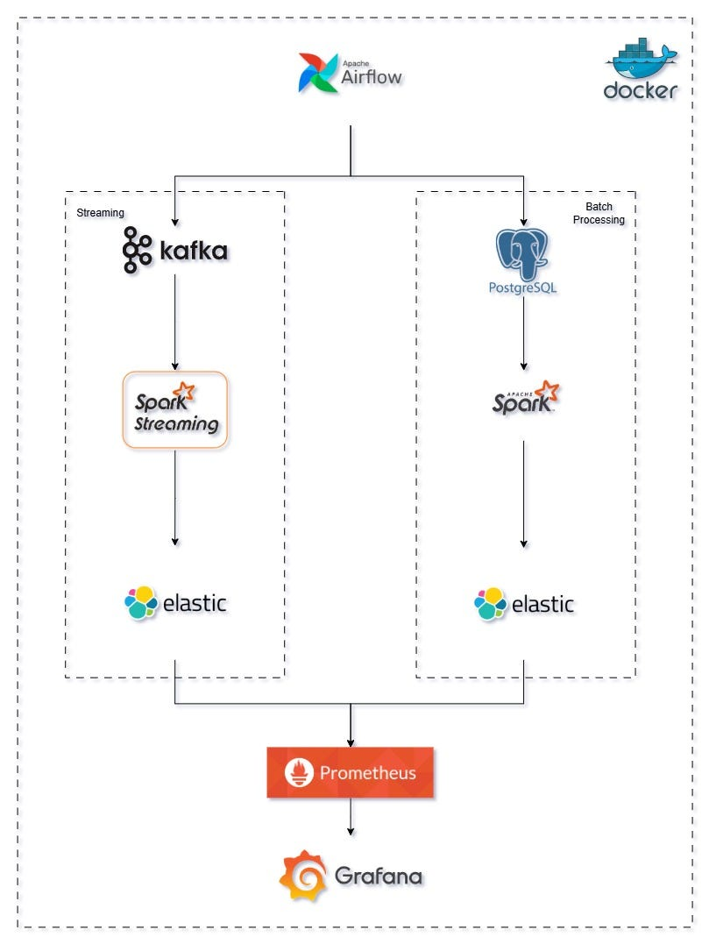
Data Pipeline Layers
B. Data Ingestion Layer
This layer collects data from sources.
Types:
Type | Description | Tools
Batch | Periodic loads (hourly/daily) | Airflow, Cron
Streaming | Real-time continuous data | Kafka, Kinesis
Key Responsibilities:
Data extraction
Format standardization
Handling failures & retries
Notes:
Source :https://github.com/Ridhic/imdb_pipeline
https://medium.com/%40ridhicrijo.2000/building-a-real-time-and-batch-data-pipeline-with-apache-spark-kafka-airflow-postgresql-and-a17cf9a5a12c

Slide 22
Data Pipeline Layers
C. Transformation Layer
This is where raw data becomes useful data.
Operations:
Cleaning (remove nulls, duplicates)
Filtering
Joining datasets
Aggregation
Enrichment (adding external data)
Example:
Raw Orders → Remove duplicates → Join with Users → Calculate revenue → Final dataset
Tools:
Python (Pandas)
Spark (big data)
dbt (SQL-based transformation)
Notes:
https://dzone.com/articles/what-is-a-data-pipeline?utm_source=chatgpt.com

Slide 23
Data Pipeline Layers
D. Storage Layer
Where processed data is stored.
Types:
Storage | Use Case
Data Lake | Raw + large-scale storage (S3, HDFS)
Data Warehouse | Structured analytics (Snowflake, BigQuery)
Lakehouse | Hybrid (Delta Lake, Iceberg)

Slide 24
Data Pipeline Layers
E. Consumption Layer
BI Tools → Tableau, Power BI
ML Models → Predictions
APIs → Data services

Slide 25
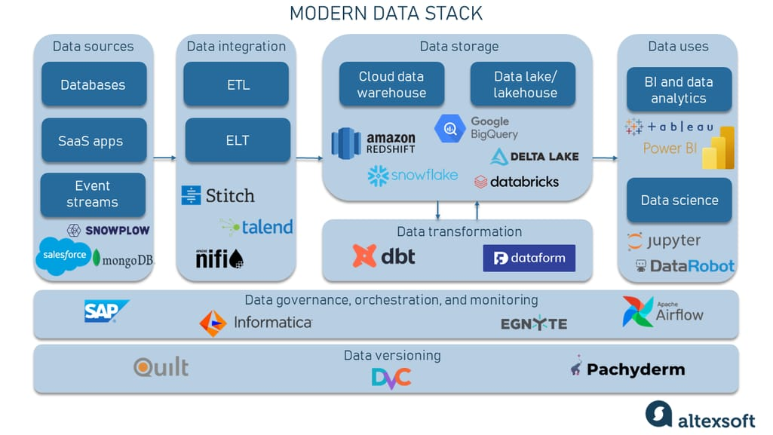
Data Stack

Slide 26
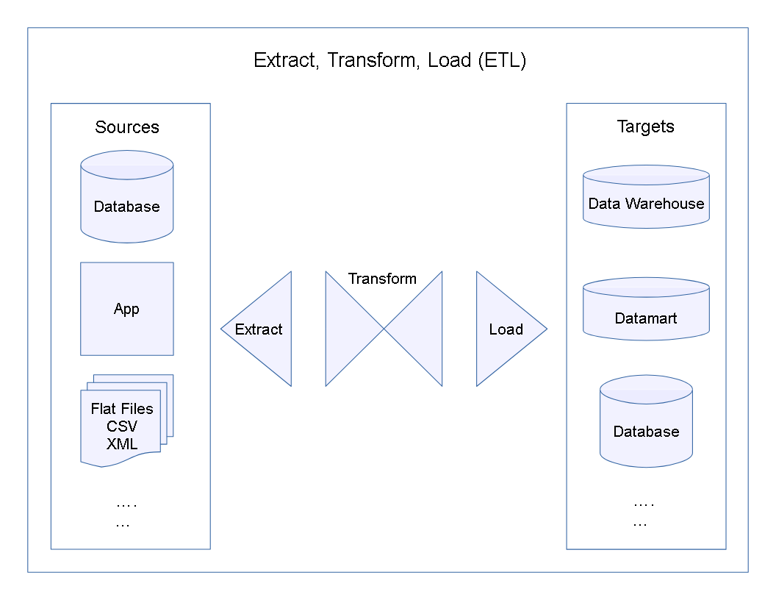
How ETL Fits into Data Pipelines
ETL = Extract → Transform → Load
Data is transformed before loading
Used in traditional systems
ELT = Extract → Load → Transform
Data is loaded first, then transformed
Used in modern cloud systems
Key Insight:
Approach | When to Use
ETL | Legacy systems, strict schema
ELT | Big data, cloud (Snowflake, BigQuery)

Slide 27
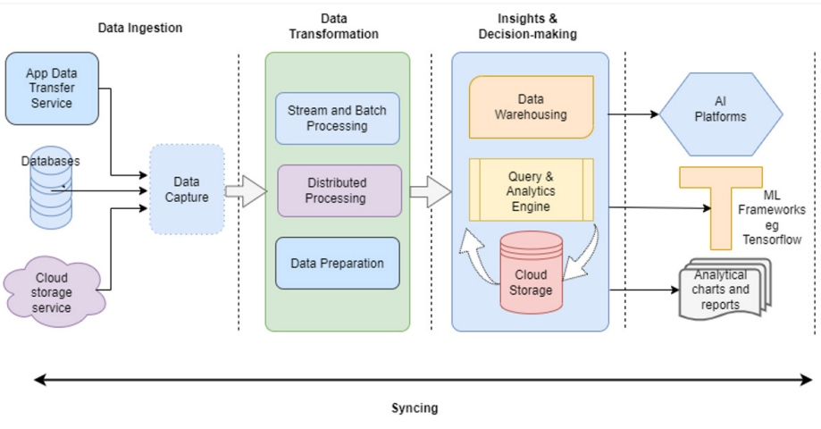
Data Ingress & Egress Concepts
Data Ingress (Incoming Data)
Meaning:
Data entering your system
Examples:
API calls
Kafka streams
File uploads (CSV, JSON)
Database replication (CDC)
Data Egress (Outgoing Data)
Meaning:
Data leaving your system
Examples:
Dashboards
ML predictions
Data exports
External APIs
Note : Cloud providers may charge for egress (outbound data)

Slide 28
Pipeline Orchestration & Scheduling
This is the brain of your pipeline.
What is Orchestration?
Managing:
Task execution
Dependencies
Failures
Retries
Example Workflow:
Step 1: Extract data Step 2: Clean data Step 3: Transform Step 4: Load to warehouse Step 5: Notify/report
Popular Tools:
Apache Airflow
Prefect
Dagster

Slide 29
Pipeline Orchestration & Scheduling
Putting It All Together
Scheduling:
Sources (DB, API, Logs)
↓
Ingestion (Kafka / Batch Jobs)
↓
Storage (Data Lake - S3)
↓
Transformation (Spark / dbt)
↓
Warehouse (Snowflake)
↓
BI / ML / APIs
↓
Users / Applications
Type | Example
Time-based | Run daily at 2 AM
Event-based | Trigger on file arrival
Dependency-based | Run after another job

Slide 30
Key Takeaways
Data pipelines are layered systems
ETL is part of pipeline, not the whole pipeline
Ingress = incoming data, Egress = outgoing data
Orchestration ensures reliability & automation
Modern pipelines favor:
Streaming + Batch hybrid
ELT over ETL
Cloud-native architecture

Slide 31
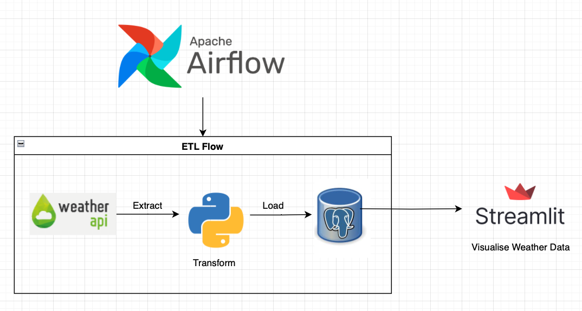
DEMO
Notes:
https://medium.com/%40pooja9900111/orchestrating-etl-pipeline-with-apache-airflow-04860c85d7a2
https://github.com/DataEngMastero/DataEnggProjects

